Slide 1
An Introduction To TypeScript
Jason Bock

Slide 2
Personal Info
http://www.jasonbock.net
https://www.twitter.com/jasonbock
https://www.github.com/jasonbock
jason.r.bock@outlook.com

Slide 3
Downloads
https://github.com/jasonbock/
IntroToTypeScript
https://github.com/JasonBock/
Presentations/blob/master/
An%20Introduction%20to%20TypeScript.pptx

Slide 4
Overview
Why TypeScript?
Language Features
Usage
Future
Remember…
https://github.com/jasonbock/
IntroToTypeScript
https://github.com/JasonBock/
Presentations/blob/master/
An%20Introduction%20to%20TypeScript.pptx

Slide 5
Why TypeScript?
JavaScript
SUCKS!
Notes:
It’s easy to say “JavaScript sucks!” That’s a clickbait-y way to start a conversation. “COBOL sucks” – but lots of companies made a lot of money on that language.

Slide 6
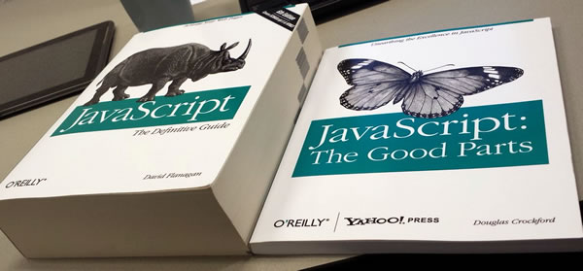
Why TypeScript?
http://www.globalnerdy.com/wordpress/wp-content/uploads/2014/08/javascript-and-the-good-parts.jpg
Notes:
Granted, we all know that JavaScript has some good things and some bad parts…

Slide 7
Why TypeScript?
console.log('4' - 4);
console.log('4' + 4);
0
44
Notes:
But the bad….well, it’s kind of bad. It’s easy to say, “well, just do the ‘good’ parts”, but that doesn’t eliminate the badness from the language

Slide 8
Why TypeScript?
Why is the method called includes and not contains?
The latter was the initial choice, but that broke code on the web (MooTools adds this method to Array.prototype).
http://www.2ality.com/2016/02/array-prototype-includes.html
Notes:
And sometimes even the good stuff (prototypical inheritance and adding methods to objects) can be abused such that it can influence the future
(As one of my coworkers said when he saw this, “Yet again showing the evil that is modifying built-in data types. Also, MooTools is why we can't have nice things ;).”)

Slide 9

Why TypeScript?
“TypeScript is a typed superset of JavaScript that compiles to plain JavaScript.”
http://www.typescriptlang.org/
Notes:
That’s essentially what TypeScript is trying to address. It allows you to add typing to JavaScript so you have a high degree of confidence in how your JavaScript will run.

Slide 10
Demo: Using the Playground
An Introduction to TypeScript
Notes:
Let’s see how TypeScript works using the TS playground - http://www.typescriptlang.org/Playground
Note: https://github.com/Microsoft/TypeScript/issues/4866, last I checked, it was 1.7.4, but it should be explicit.

Slide 11

Features
Add.ts
function add(x: number, y: number): number {
return x + y;
}
Add.js
function add(x, y) {
return x + y;
}
https://upload.wikimedia.org/wikipedia/commons/thumb/d/dd/Pink-eraser.svg/570px-Pink-eraser.svg.png
Notes:
So, as you just saw, the TypeScript compiler translates the TS code into idiomatic JavaScript. A lot of information is “erased” at that point, but that’s OK, because we gain a lot of safety as we develop our applications. Furthermore, we don’t have to be limited, or to an arguably large degree, about what the JavaScript ends up looking like. So, let’s forget now what JS is produced, and dive into all the TS language features.

Slide 12
Demo: Using VS Code for TypeScript Features
An Introduction to TypeScript
Notes:
We’ll now dive into TypeScript language features. To do that, we’ll use VS Code.
https://code.visualstudio.com/Docs/languages/typescript
Note: hiding .js files and the font size were changes in my user settings: C:\Users\jasonb\AppData\Roaming\Code\User\settings.json
File -> Preferences -> User Settings

Slide 13
Features
Variables
Straightforward – “var answer = 44;”
Can be explicit about type – “var answer : number = 44;”
Basic types: boolean, number, string
Arrays
var answers : number[] = [44, 42]; (can be inferred as well)
Array<> can be used (generics will be covered later)
Enums
enum Answers { Correct = 44, Wrong = 42 }
If no value is specified, number starts at 0
Any and void
Any lets anything go (like dynamic in C#)
void – used for methods that return nothing (not required)

Slide 14
Features
Basic language features
Template strings: `The answer is {this._value}` (note the tick mark, it’s required)
Ternary: this._value = value == null ? 44 : value;
let and const
let allows for scoped variables
const allows for constant values
Object.freeze() should be used for immutable values
Try…catch…finally is supported

Slide 15
Features
Methods
Can take any number of arguments, and can also specify types if desired
Return type can be deferred from “return” statements
Anonymous methods can be declared
Arguments
Methods must be called with correct number of parameters
Optional arguments can be declared with “?” after the name
Or, use a default argument value (makes it optional)
“Rest” parameters, use “…” to grab multiple optional arguments

Slide 16
Features
Classes and interfaces
Interfaces define structural contracts (“implements”)
Classes define structural contracts and behavior (“extends”)
Visibility
Public (anyone), private (only that class), protected (that class and descendants)
Properties
Use “get” and “set”
Visibility must be same (can’t mix)
Can use “readonly” fields

Slide 17
Features
Classes and interfaces (con’t)
Overloading methods
It’s possible, but really awkward
Just better off declaring a method with a different name
Mixins
“implement” multiple classes
Really you’re implementing the structural contract of a class

Slide 18
Features
Modules
Analogous to namespaces in C#
Only way to declare a const within some “scope”
Internal
Just use “module”. Other classes within that TS file will see members within the module IF they use “export”
Use triple-slash reference to help the compiler and tooling
External
Use the import keyword to “require” the module
You can use require(), but “import * as someName from “…”” is a cleaner way

Slide 19
Features
Types and Generics
Type guards – this or that or something else -> A | B | C
Type assertions – “duck typing”. This isn’t casting, you’re just telling the compiler you know more.
Generics
You can use generic parameters in TypeScript to create reusable, safe code
I.e. you don’t have to use “object” or “any”; you can be specific with the type used
E.g. Array<string> or Array<Person>
Constrained - <T extends Person>
“new”

Slide 20
Features
Iterators
For statements…(for i = 0;…)
For-in statements….but be careful what you’re iterating, it’s the keys
For-of statements…works like “foreach” in C#

Slide 21
Features
Asynchronous code
JS traditionally used callbacks
Then we moved to promises
Now TS (and JS) has async and await

Slide 22
Features
.d.ts files
If you’re doing everything in TS (ExternalModules example), everything….works
If you’re using a JS library like moment.js (http://momentjs.com/), you need the .d.ts file for TS to get type information
npm install --save @types/moment
If you want to generate a .d.ts
From TS files, use “declaration” compiler switch
From C#, consider TypeLite (http://type.litesolutions.net/)

Slide 23
Features
Decorators
Origination was arguably with AtScript
Annotations, or decorations, were put into TypeScript
https://github.com/Microsoft/TypeScript/issues/1557
Can decorate properties, classes, methods and parameters
Is somewhat advanced, but it’s worth diving into
Interception capabilities
Powerful extension mechanisms (e.g. dependency injection)
Metaprogramming
Serialization

Slide 24
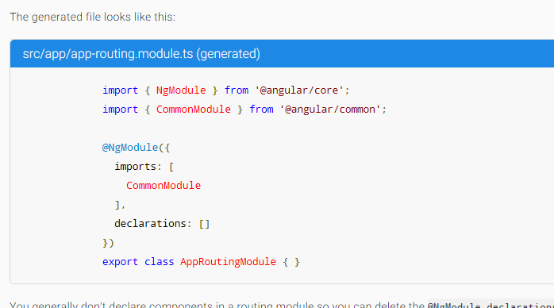

Usage
https://angular.io/
Notes:
Where is TypeScript being used? It’s what Angular 2.0 was built upon.

Slide 25
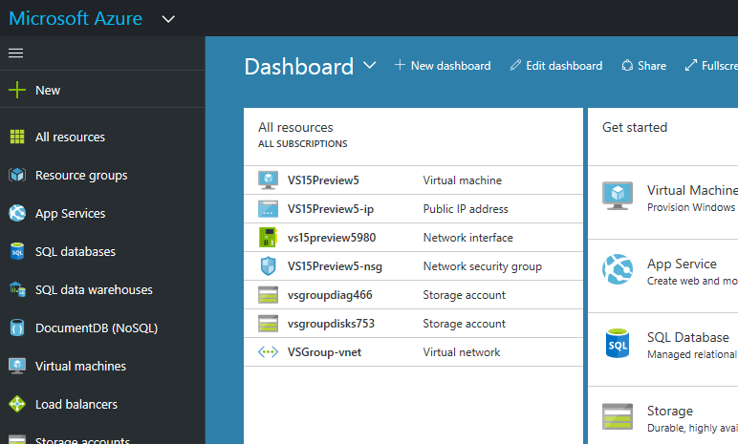
Usage
https://portal.azure.com/#
Notes:
The Azure Portal is written in TypeScript.

Slide 26
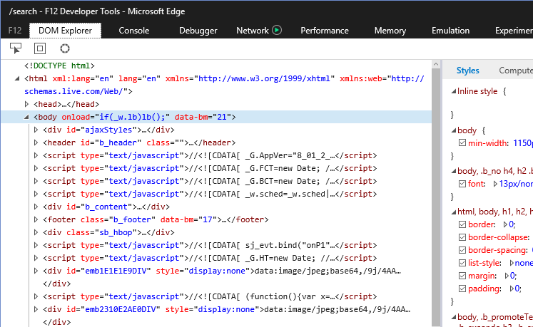
Usage
https://dev.windows.com/en-us/microsoft-edge/platform/documentation/f12-devtools-guide/
Notes:
The developer tools for Edge are written in TypeScript.

Slide 27
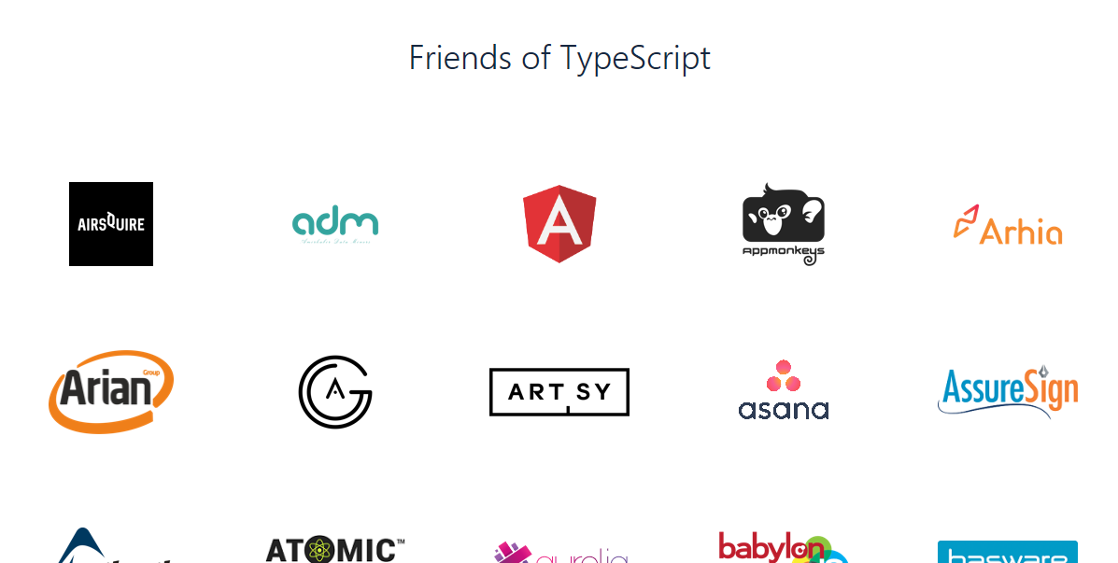
Usage
https://www.typescriptlang.org/community/friends.html
Notes:
There’s a lot of other places TypeScript is being used – check the site for more details.

Slide 28

Future
Async Functions
ES2019
Shared Memory
Atomics
https://tc39.github.io/ecma262/
Notes:
Now, granted, JavaScript has rapidly matured in the past 5 years, with new frameworks and toolchains popping up every day (at least that’s what it seems like). Also, the language is getting updates to modernize the language. Part of this accelerated process has been the need for JavaScript to remove the cruft of years gone by and provide modern programming constructs. TypeScript is definitely a motivational factor here.

Slide 29

Future
Future
Support for project references/composite projects
Variadic types
Investigate nominal typing support
Flattening declarations
Implement new ES Decorator proposal
Investigate Ambient, Deprecated, and Conditional decorators
Investigate error messages in haiku or iambic pentameter
Decorators for function expressions/arrow functions
2.9
Support number and symbol named properties with keyof and mapped types
Support for passing generics to JSX elements
Support for passing generics to tagged template calls
Allow import(...)-ing types at any location
--pretty error output by default
…
https://github.com/Microsoft/TypeScript/wiki/Roadmap
Notes:
TypeScript has a roadmap of future features. Some map to upcoming JavaScript features, and some are just TS language features.

Slide 30
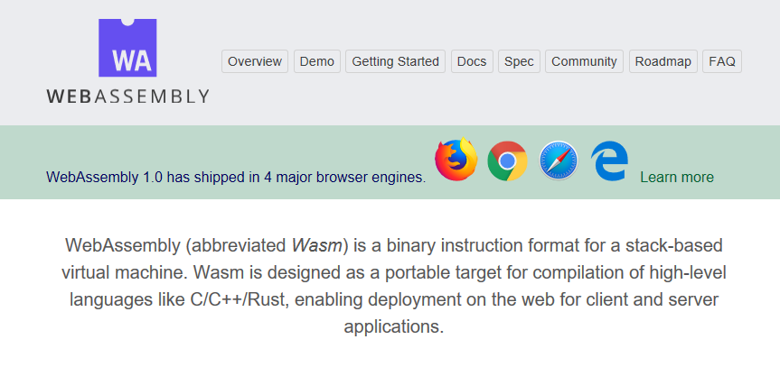
Future
https://webassembly.org/
Notes:
WebAssembly is a new binary format in place for web applications. This makes it possible for any language to compile to this format, rather than transpiling to JavaScript. There’s no reason TypeScript couldn’t compile to this native format in the future.

Slide 31
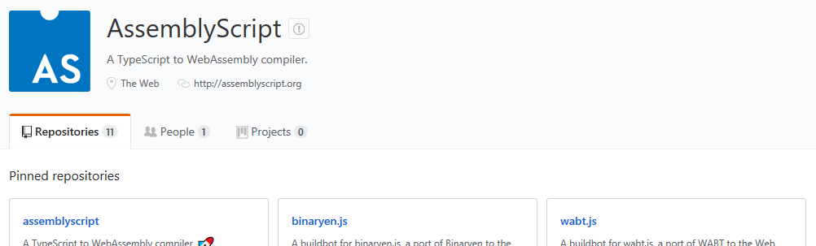
Future
https://github.com/AssemblyScript
Notes:
In fact, there’s AssemblyScript, which compiles TS directly to WebAssembly

Slide 32
Demo: Playing With AssemblyScript
An Introduction to TypeScript
Notes:
Let’s see how AssemblyScript works.

Slide 33




Conclusion
Notes:
TypeScript is a widely-used language that is evolving all the time. More web applications are using TS over JS. Definitely give it a whirl!

Slide 34
An Introduction To TypeScript
Jason Bock
Remember…
https://github.com/jasonbock/IntroToTypeScript
https://github.com/JasonBock/Presentations/blob/master/An%20Introduction%20to%20TypeScript.pptx
References in the notes on this slide
Notes:
References:
Using decorators and observables to implement retry - https://blog.strongbrew.io/decorators-and-observables-to-implement-retry-logic/
A Better TypeScript Playground - https://agentcooper.github.io/typescript-play/
TypeScript: Everyone’s type of JavaScript - https://jaxenter.com/typescrip-leader-typed-javascript-143329.html
Announcing TypeScript 2.8 - https://blogs.msdn.microsoft.com/typescript/2018/03/27/announcing-typescript-2-8/
A Look at TypeScript's Conditional Types - http://koerbitz.me/posts/a-look-at-typescripts-conditional-types.html
Announcing TypeScript 2.8 RC - https://blogs.msdn.microsoft.com/typescript/2018/03/15/announcing-typescript-2-8-rc/
Current state of compiling TypeScript to WebAssembly - https://wanago.io/2018/02/19/current-state-compiling-typescript-webassembly/
Type-Driven Development with TypeScript - http://www.olioapps.com/blog/type-driven-development-with-typescript/
TypeScript 2.7: Numeric Separators - https://blog.mariusschulz.com/2018/02/16/typescript-2-7-numeric-separators
Announcing TypeScript 2.7 RC - https://blogs.msdn.microsoft.com/typescript/2018/01/17/announcing-typescript-2-7-rc/
Why does TypeScript Sometimes Fails to Type Check Extra Properties? - https://medium.com/@lemoine.benoit/why-does-typescript-sometimes-fails-to-type-check-extra-properties-fd230ebbc295
Converting 600k lines to TypeScript in 72 hours - https://www.lucidchart.com/techblog/2017/11/16/converting-600k-lines-to-typescript-in-72-hours/
TypeScript Practical Introduction - https://auth0.com/blog/typescript-practical-introduction/
Announcing TypeScript 2.6 - https://blogs.msdn.microsoft.com/typescript/2017/10/31/announcing-typescript-2-6/
The first TypeScript demo - https://medium.com/@lukeh/the-first-typescript-demo-905ea095a70f
TypeScript: JavaScript + Types = Awesome Developer Productivity - Type Annotations - https://www.barbarianmeetscoding.com/blog/2017/09/07/typescript-javascript-plus-types-equals-awesome-developer-productivity-type-annotations/
Understanding and Embracing TypeScript’s “readonly” - https://spin.atomicobject.com/2017/08/14/typescript-readonly-intro/
Dynamic import: I've been awaiting you... - https://blog.johnnyreilly.com/2017/07/dynamic-import-ive-been-await-ing-you.html
Announcing TypeScript 2.4 - https://blogs.msdn.microsoft.com/typescript/2017/06/27/announcing-typescript-2-4/
TypeScript 2.3: Generic Parameter Defaults - https://blog.mariusschulz.com/2017/06/02/typescript-2-3-generic-parameter-defaults
TypeScript 2.2: Mixin Classes - https://blog.mariusschulz.com/2017/05/26/typescript-2-2-mixin-classes
Announcing TypeScript 2.3 - https://blogs.msdn.microsoft.com/typescript/2017/04/27/announcing-typescript-2-3/
Quick Start - http://www.typescriptlang.org/docs/tutorial.html
TypeScript 2.2: Dotted Properties and String Index Signatures - https://blog.mariusschulz.com/2017/03/03/typescript-2-2-dotted-properties-and-string-index-signatures
Editing TypeScript - https://code.visualstudio.com/Docs/languages/typescript
Using TypeScript in Visual Studio Code - http://blogs.msdn.com/b/typescript/archive/2015/04/30/using-typescript-in-visual-studio-code.aspx
TypeScript: The Nitty-Gritty Parts - https://medium.com/@sebastiansebald/typescript-the-nitty-gritty-parts-85313547a182#.5atns4w6x
TypeScript 2.2: The object Type - https://blog.mariusschulz.com/2017/02/24/typescript-2-2-the-object-type
Announcing TypeScript 2.2 - https://blogs.msdn.microsoft.com/typescript/2017/02/22/announcing-typescript-2-2/
TypeScript + Node.js Enterprise Patterns - http://consoledotblog.com/2017/01/typescript-node-js-enterprise-patterns/
TypeScript Deep Dive - https://www.gitbook.com/book/basarat/typescript/details
Announcing TypeScript 2.2 RC - https://blogs.msdn.microsoft.com/typescript/2017/02/02/announcing-typescript-2-2-rc/
TypeScript 2.1: Improved Inference for Literal Types - https://blog.mariusschulz.com/2017/01/27/typescript-2-1-improved-inference-for-literal-types
Announcing TypeScript 2.1 - https://blogs.msdn.microsoft.com/typescript/2016/12/07/announcing-typescript-2-1/
TypeScript 2.0: The "never" Type - https://blog.mariusschulz.com/2016/11/18/typescript-2-0-the-never-type
TypeScript 2.0 is now available! - https://blogs.msdn.microsoft.com/typescript/2016/09/22/announcing-typescript-2-0/
Announcing TypeScript 2.0 RC - https://blogs.msdn.microsoft.com/typescript/2016/08/30/announcing-typescript-2-0-rc/
What's new in TypeScript - https://github.com/Microsoft/TypeScript/wiki/What%27s-new-in-TypeScript
Roadmamp - https://github.com/Microsoft/TypeScript/wiki/Roadmap
Announcing TypeScript 1.7 - http://blogs.msdn.com/b/typescript/archive/2015/11/30/announcing-typescript-1-7.aspx
Even Better Data Typing with TypeScript 1.4 - https://visualstudiomagazine.com/articles/2015/06/26/better-data-typing-typescript-1-4.aspx
TypeScript: The Best Way to Write JavaScript - http://www.codemag.com/article/1511051
Exploiting Generics in TypeScript - https://visualstudiomagazine.com/articles/2015/12/01/exploiting-generics.aspx
Overloading TypeScript Functions - https://visualstudiomagazine.com/articles/2015/11/01/overloading-typescript-functions.aspx
Implementing Strategy Pattern and Callbacks in TypeScript - https://visualstudiomagazine.com/articles/2015/10/01/implementing-strategy-pattern.aspx
Managing Functions in TypeScript - https://visualstudiomagazine.com/articles/2015/09/01/managing-functions-in-typescript.aspx
TypeScript: A New Language for .NET and JavaScript Developers - http://rachelappel.com/typescript-a-new-language-for-.net-and-javascript-developers
Exploiting TypeScript Arrays - https://visualstudiomagazine.com/articles/2016/01/01/exploiting-typescript-arrays.aspx
I Hated JavaScript - https://alexandrebrisebois.wordpress.com/2016/01/28/i-hated-javascript/
TypeScript Deep Dive - https://basarat.gitbooks.io/typescript/
TypeScript Compiler Options - https://github.com/Microsoft/TypeScript/wiki/Compiler-Options
Angular 2 and TypeScript - https://blog.mariusschulz.com/2015/03/06/angular-2-and-typescript
Aurelia Starter Kit - http://aurelia.io/docs.html#/aurelia/framework/latest/doc/article/getting-started
Extending Visual Studio Code - https://code.visualstudio.com/docs/extensions/overview
ES6-const - https://mathiasbynens.be/notes/es6-const
Decorators & metadata reflection in TypeScript: From Novice to Expert (Part I) - http://blog.wolksoftware.com/decorators-reflection-javascript-typescript
How to implement a typescript decorator? - http://stackoverflow.com/questions/29775830/how-to-implement-a-typescript-decorator
Basic Typescript Dependency Injection with Decorators - http://jonnyreeves.co.uk/2015/basic-typescript-dependency-injection-with-decorators/
Adding TypeScript Support to an Existing Project -
http://drew5.net/code/bits-and-bytes-adding-typescript-support-to-an-existing-project/
Setting up a TypeScript + Visual Studio Code development environment - http://blog.wolksoftware.com/setting-up-your-typescript-vs-code-development-environment
Setting up Aurelia with Typescript in Visual Studio 2015 - http://www.marwijnchristiaans.com/?p=6
TypeScript 2.0:
TypeScript 2.0: Non-Nullable Types - https://blog.mariusschulz.com/2016/09/27/typescript-2-0-non-nullable-types
TypeScript 2.0: Control Flow Based Type Analysis - https://blog.mariusschulz.com/2016/09/30/typescript-2-0-control-flow-based-type-analysis
TypeScript 2.0: Acquiring Type Declaration Files - https://blog.mariusschulz.com/2016/10/23/typescript-2-0-acquiring-type-declaration-files

